Slide 1
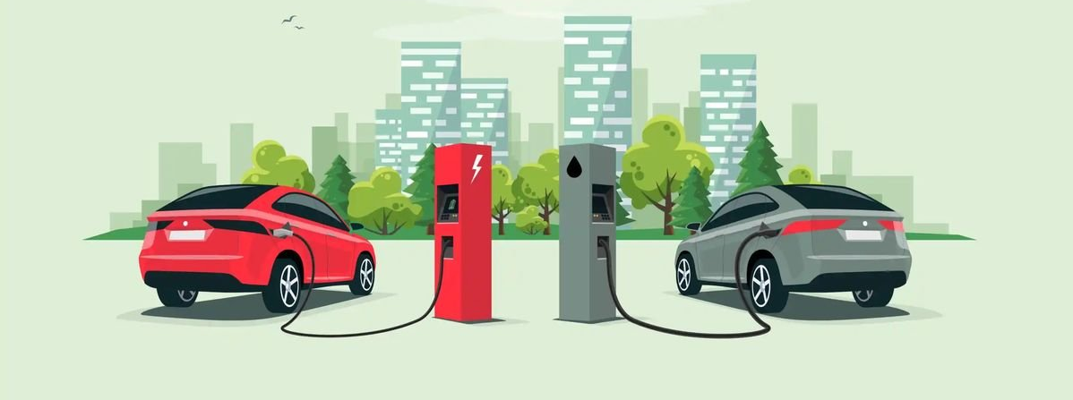

AtliQ motors
A Data-Driven Blueprint for AtliQ Motors' India Entry .
Unlocking the world's most dynamic EV market through strategic disruption.
DETECT. ANALYZE. AUTOMATE.

Slide 2
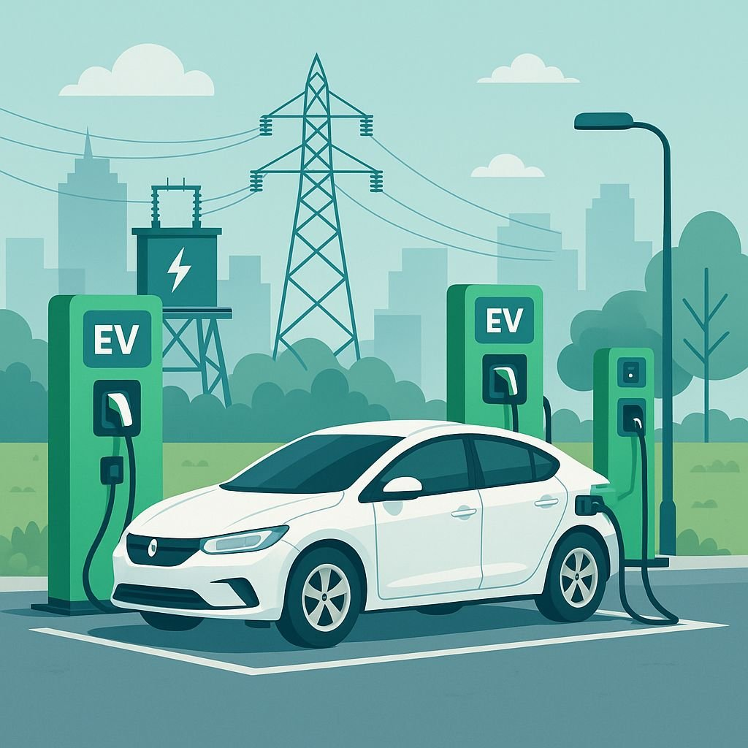
Problem Statement
AtliQ Motors is a leading automotive company based in the USA, specializing in electric and hybrid vehicles
Over the past 5 years, the company has achieved a 25% market share in the North American EV segment, establishing itself as a key industry player
As part of its global expansion strategy, AtliQ Motors plans to enter the Indian market, where its current market share is below 2%
To support this expansion, Bruce Haryali, Head of AtliQ Motors India, has initiated a comprehensive analysis of the Indian EV market

Slide 3
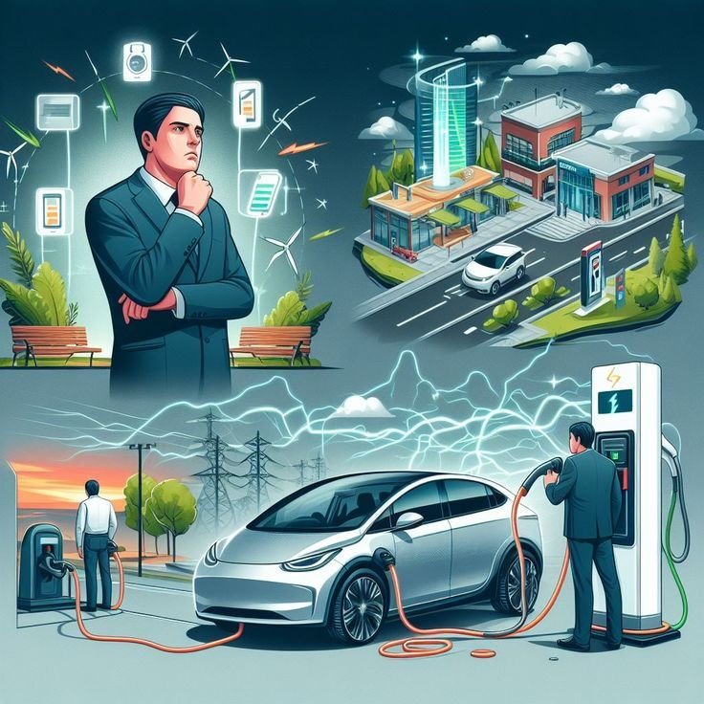
Objective & Scope of Analysis
Objective
To conduct a comprehensive market study of the EV/Hybrid industry in India and gain insights into current market dynamics.
Scope of Analysis
EV sales trends (2022–2024)
Penetration rates across states
Market trends & growth patterns
Key business insights for expansion

Slide 4


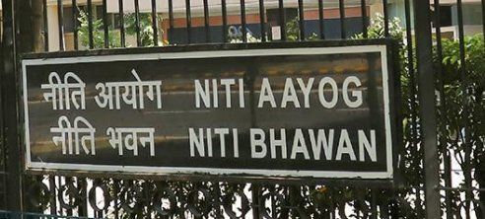

Data collection

Slide 5
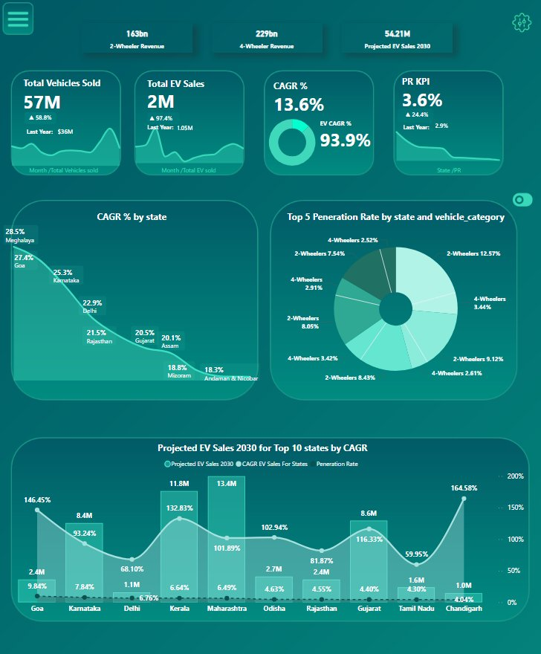
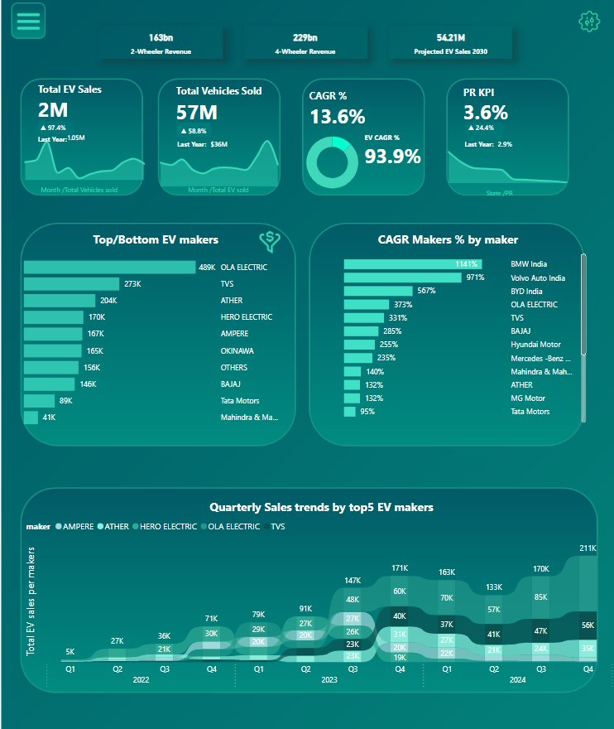
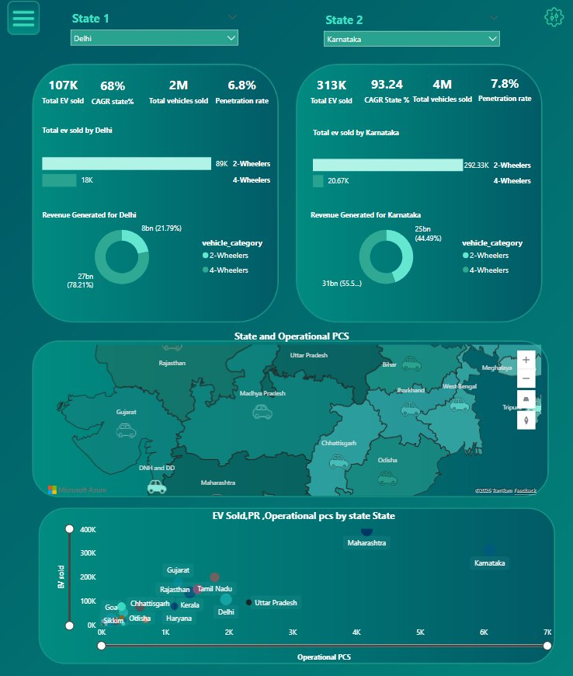
Dashboard overview
State analysis
Maker analysis
State comparision

Slide 6
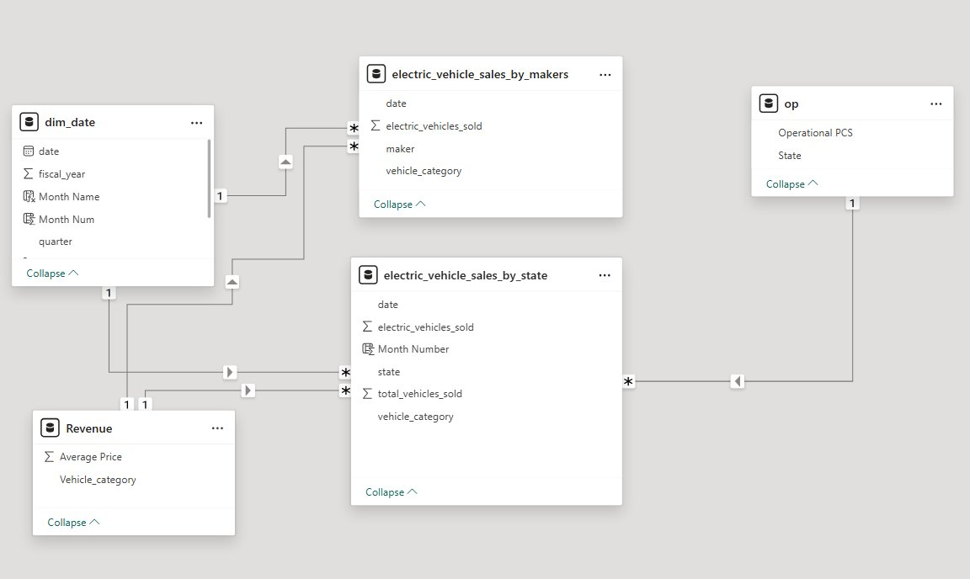
Data Model

Slide 7
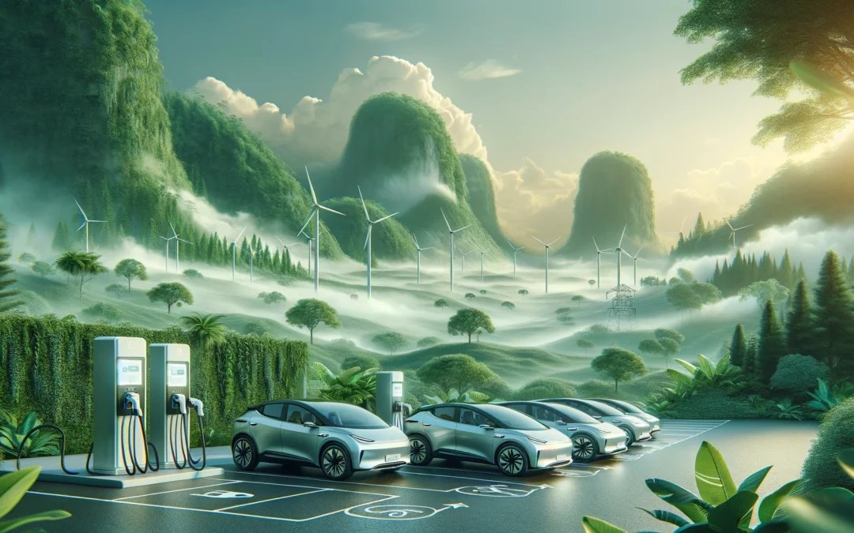
Primary Questions
Q1: Top & Bottom 3 manufacturers (2W sales) – FY 2023 & 2024
Q2: Top 5 states by EV penetration (2W & 4W) – FY 2024
Q3: States with negative EV penetration growth (2022–2024)
Q4: Quarterly sales trends – Top 5 EV makers (4W) (2022–2024)
Q5: EV sales & penetration comparison – Delhi vs Karnataka (2024)
Q6: CAGR analysis – Top 5 makers (4W) (2022–2024)
Q7: Top 10 states by CAGR in total vehicle sales (2022–2024)
Q8: Peak & low EV sales months (2022–2024)
Q9: EV sales projection for 2030 (Top 10 states by penetration)
Q10: Revenue growth analysis (2W & 4W EVs)

Slide 8
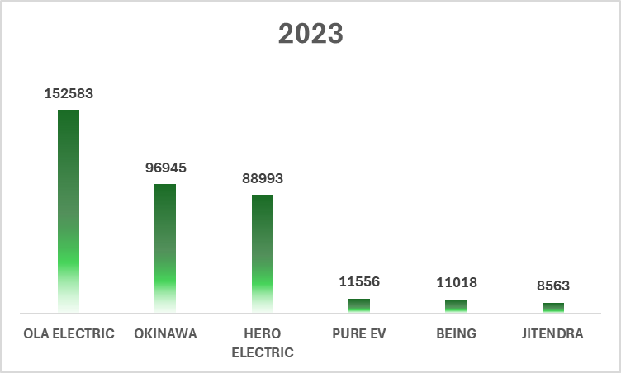
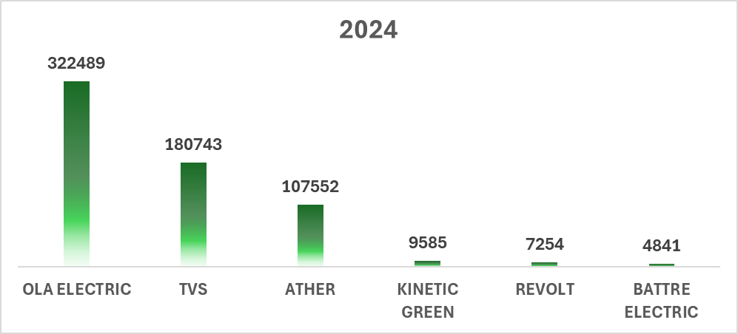
Qn 1 : List the top 3 and bottom 3 makers for the fiscal years 2023 and 2024 in terms of the number of 2-wheelers sold.
OLA Electric dominates both years with strong growth
TVS and Ather entered top 3 in 2024
Hero Electric dropped out of top 3 in 2024
Bottom players show very low and declining sales
Market is becoming highly competitive and concentrated

Slide 9
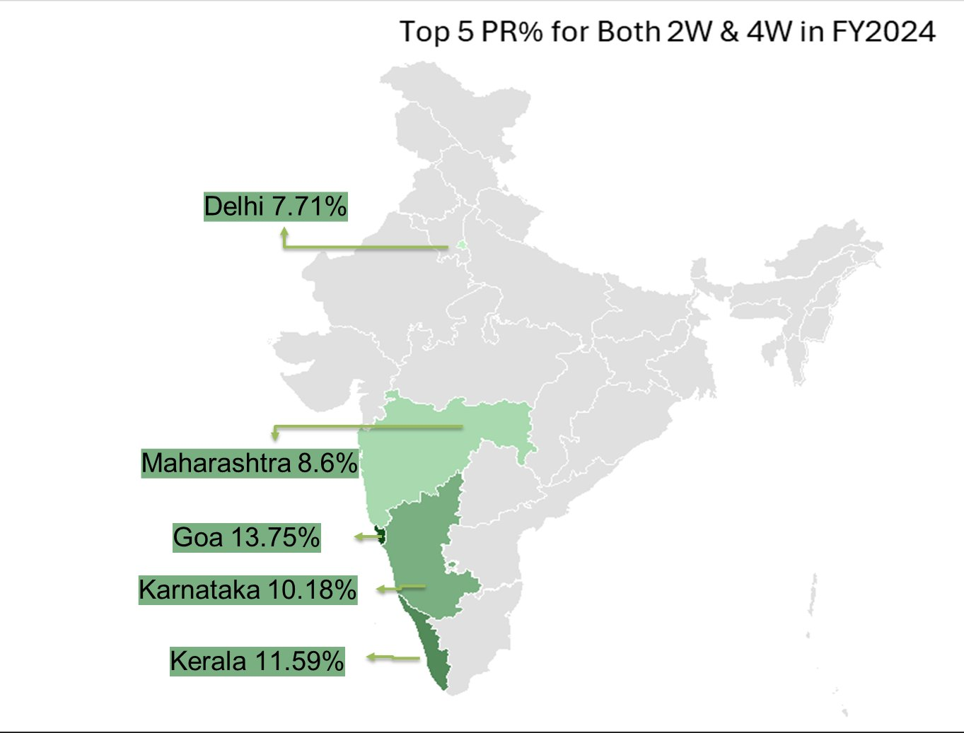
Qn 2: Identify the top 5 states with the highest penetration rate in 2-wheeler and 4-wheeler EV sales in FY 2024.
Goa leads with the highest EV penetration (13.75%)
Southern states like Karnataka & Kerala show strong adoption
Large markets like Maharashtra & Delhi have lower penetration %
Indicates untapped growth potential in metro markets

Slide 10
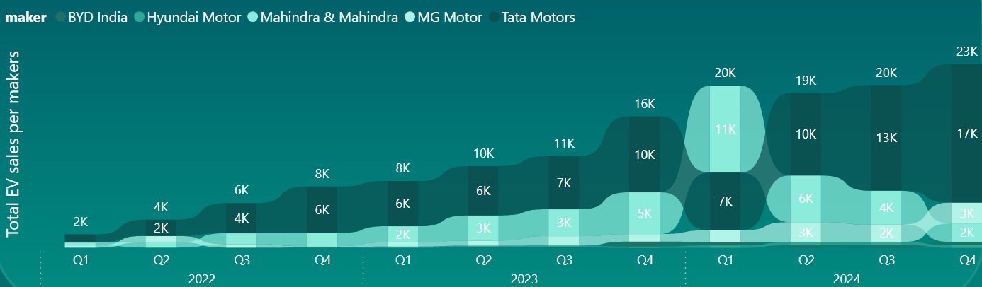
Q4: Quarterly sales trends – Top 5 EV makers (4W) (2022–2024)
Strong upward growth across all quarters from 2022 to 2024, with 2024 marking a rapid acceleration phase in EV adoption
Tata Motors dominates the market, showing significantly higher sales volumes and consistent leadership throughout all quarters
Clear seasonality observed, with Q4 peaking each year, supported by festive demand and year-end purchase trends

Slide 11
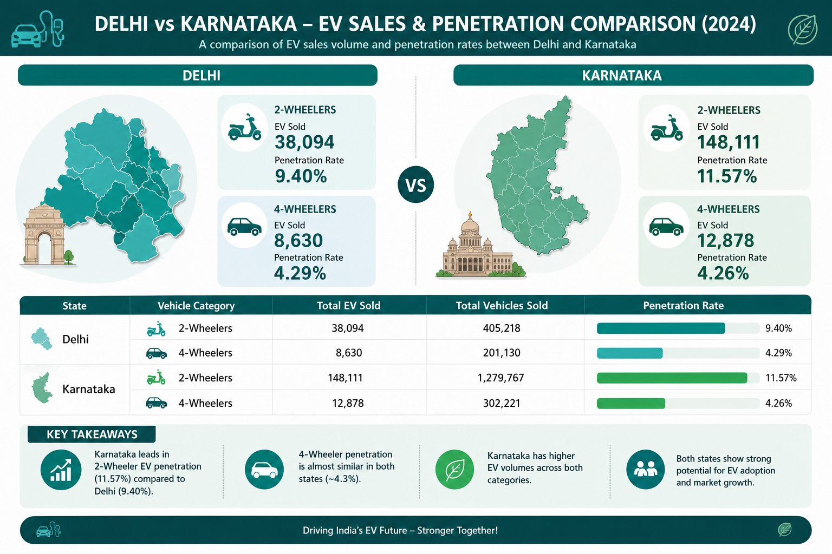
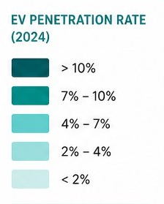
Q5: EV sales & penetration comparison – Delhi vs Karnataka (2024)
Karnataka leads in 2-wheeler EV adoption with a penetration rate of 11.57%, compared to 9.40% in Delhi
EV sales volume is significantly higher in Karnataka across both segments, indicating a larger and more mature EV market
4-wheeler EV penetration is nearly equal in both states (~4.3%), showing similar adoption levels in the premium segment
Delhi shows strong adoption despite lower total volumes, indicating high potential in a dense urban market
Both states demonstrate strong growth potential, with increasing adoption driven by infrastructure, awareness, and policy support

Slide 12
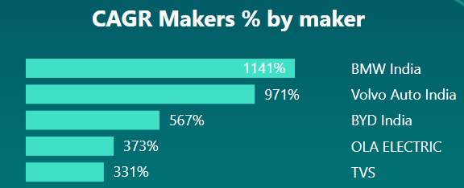
Q6: CAGR analysis – Top 5 makers (4W) (2022–2024)
BMW India leads with an exceptional CAGR of 1141%, indicating explosive growth in the premium EV segment
Volvo Auto India follows closely (971%), reinforcing strong momentum in luxury EV adoption
BYD India shows robust growth (567%), highlighting increasing competition from global EV players
Mass-market players like OLA ELECTRIC and TVS Motor Company show steady but lower CAGR, indicating more stable, volume-driven growth
Overall trend shows rapid expansion across all players, with premium segment growing faster than mass market

Slide 13
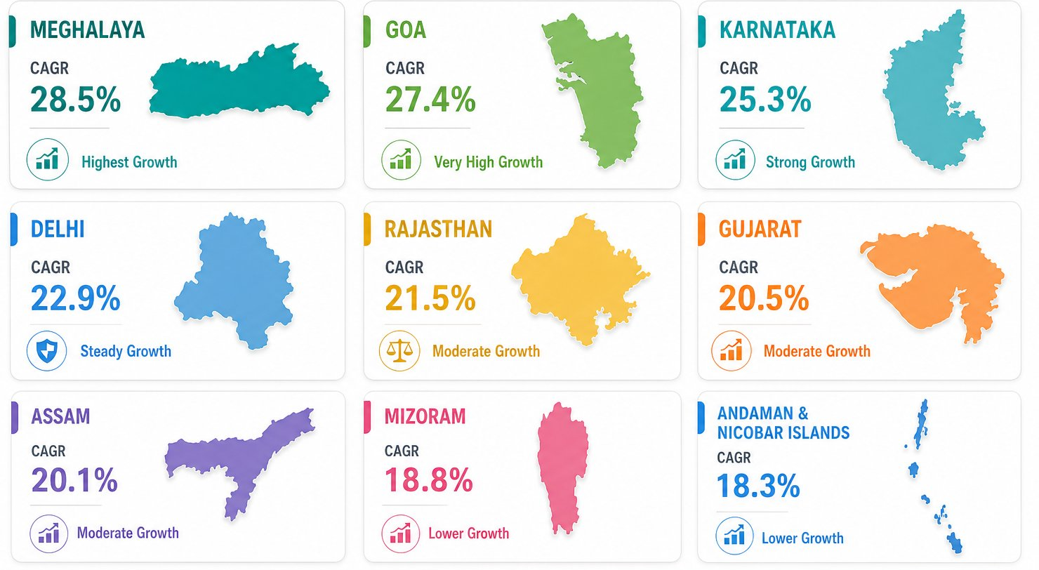
CAGR by State (2022–2024)
Q7: Top 10 states by CAGR in total vehicle sales (2022–2024)
Meghalaya leads with the highest CAGR (28.5%), followed by Goa and Karnataka, indicating strong growth in emerging and coastal markets
Mid-tier growth observed in Delhi, Rajasthan, and Gujarat, reflecting stable expansion in established markets
North-East states like Assam and Mizoram show consistent growth, highlighting rising EV adoption beyond metro regions
Lower CAGR in Andaman and Nicobar Islands and Mizoram, indicating slower but steady adoption phases
Overall trend shows EV growth expanding from metro to emerging regions, signaling market diversification and future scalability

Slide 14
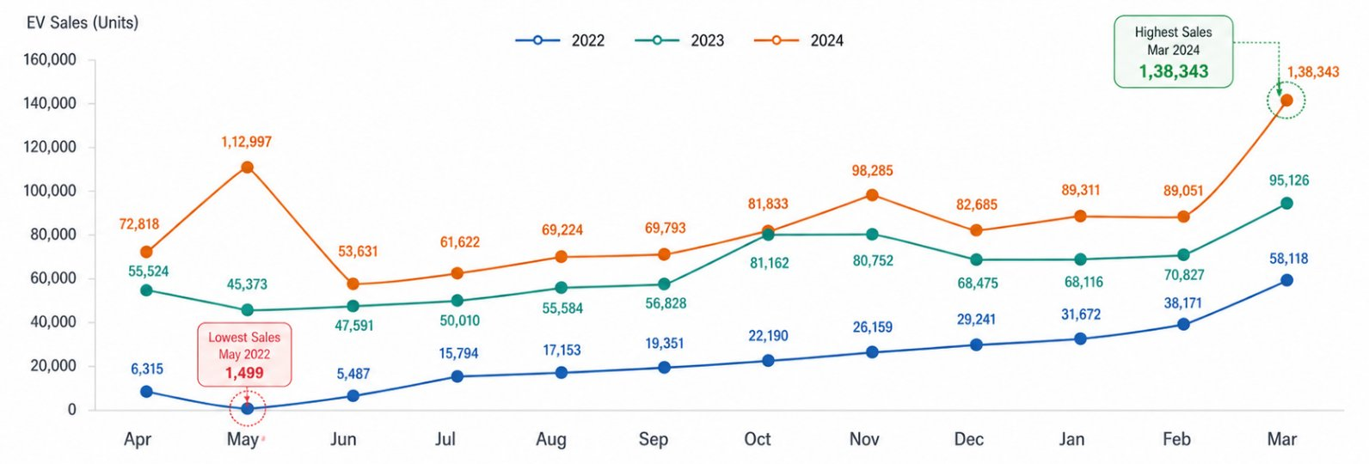
Q8: Peak & low EV sales months (2022–2024)
EV sales increase significantly from 2022 → 2024, showing rapid market expansion and rising adoption Sales generally start lower in early months and increase toward year-end, indicating a clear growth pattern Sales peak during October–March, driven by festive demand, offers, and financial year-end purchases March records the highest sales across all years (peak: Mar 2024 – 1,38,343) Especially May shows the lowest sales (lowest: May 2022 – 1,499)

Slide 15
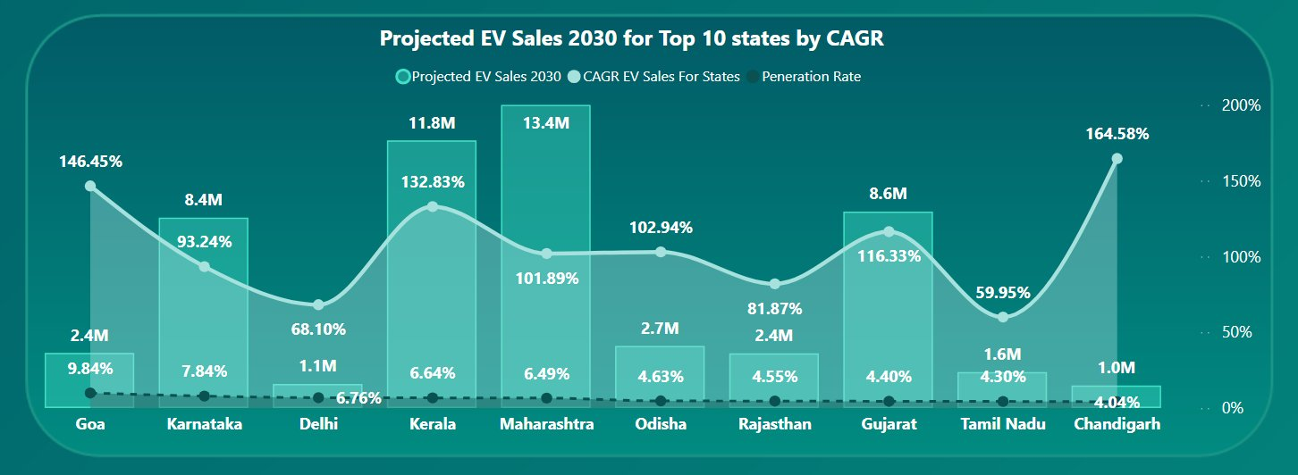
Q9: EV sales projection for 2030 (Top 10 states by penetration)
Peak Sales Performance (March): March is consistently the highest-performing month for EV sales across all analyzed years, significantly outperforming other months with a three-year aggregate of approximately 291,587 units.
Low Sales Performance (June and May): The lowest sales typically occur in the first quarter of the fiscal year, with June and May recording the lowest aggregate volumes (approximately 106,709 and 159,869 units respectively).
Fiscal Year Consistency: The "Peak" in March remained stable from 2022 through 2024, while the "Low" period shifted slightly from May in fiscal years 2022 and 2023 to June in fiscal year 2024.

Slide 16
Q10: Revenue growth analysis (2W & 4W EVs)
2-Wheelers drive volume growth, with sales rising significantly and dominating overall EV adoption
4-Wheelers lead in revenue and faster growth, showing strong expansion in the premium segment
Market split is clear: 2W = volume-driven, while 4W = value-driven with higher growth momentum

Slide 17
Secondary Research Questions
What are the primary reasons for customers choosing 4-wheeler EVs in 2023 and 2024 (cost savings, environmental concerns, government incentives)?
How do government incentives and subsidies impact the adoption rates of 2-wheelers and 4-wheelers? Which states in India provided most subsidies?
How does the availability of charging stations infrastructure correlate with the EV sales and penetration rates in the top 5 states?
Who should be the brand ambassador if AtliQ Motors launches their EV/Hybrid vehicles in India and why?
Which state of India is ideal to start the manufacturing unit? (Based on subsidies provided, ease of doing business, stability in governance etc.)
top 3 recommendations for AtliQ Motors.

Slide 18

Qn 1: the primary reasons for customers choosing 4-wheeler EVs in 2023 and 2024 (cost savings, environmental concerns, government
incentives)

Slide 19
Factor | Description | Impact on Customers
Lower Running Cost | Electricity is cheaper than petrol/diesel; fewer moving parts reduce servicing costs | Major cost savings in long-term ownership
Environmental Awareness | EVs produce zero tailpipe emissions and reduce carbon footprint | Appeals to eco-conscious buyers
Government Incentives | Subsidies under FAME II Scheme + tax benefits | Reduces initial purchase cost
Rising Fuel Prices | Petrol/diesel prices continue to increase | EVs become more economical over time
Tech Advancements | Better battery range, smart features, fast charging | Improves driving experience & trust
Urban Suitability | Ideal for daily commuting & city travel | Convenient for home charging users
Social Influence | Early adopters & status symbol effect | Attracts young professionals
Model Availability | More EV options across price segments | Increased consumer choice

Slide 20
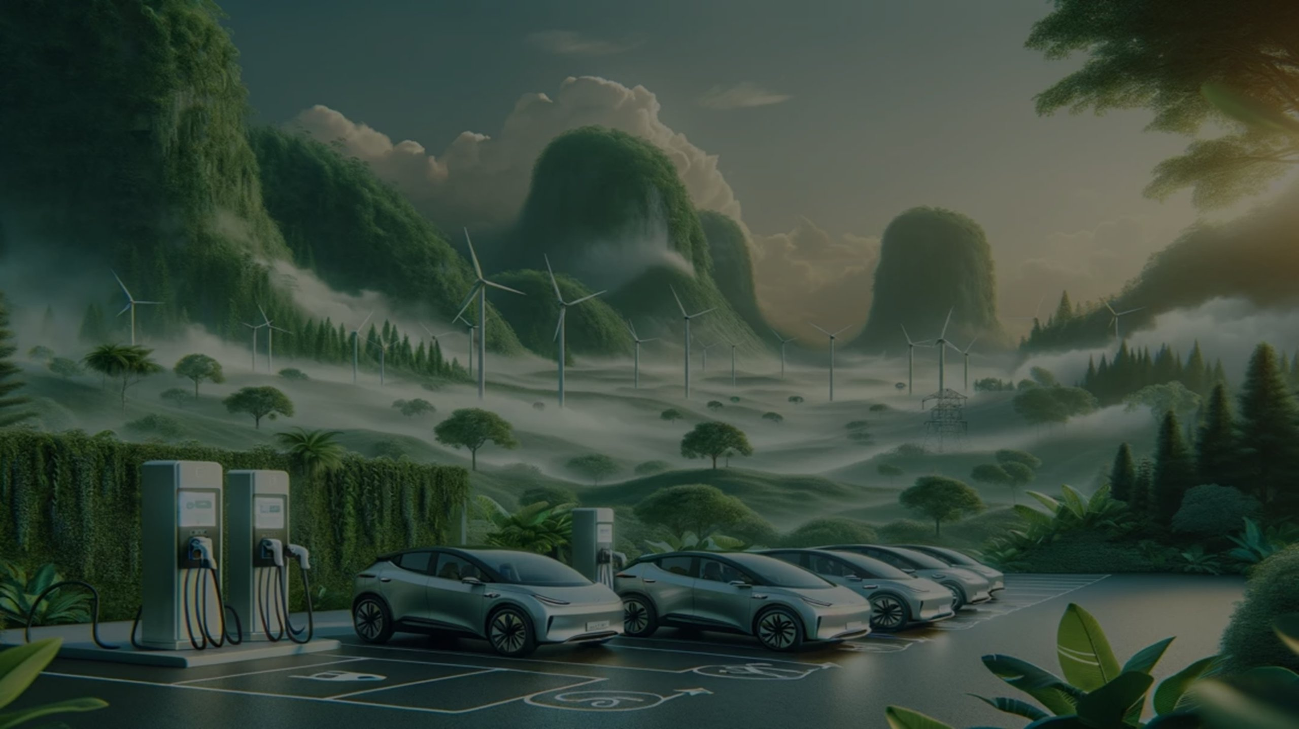
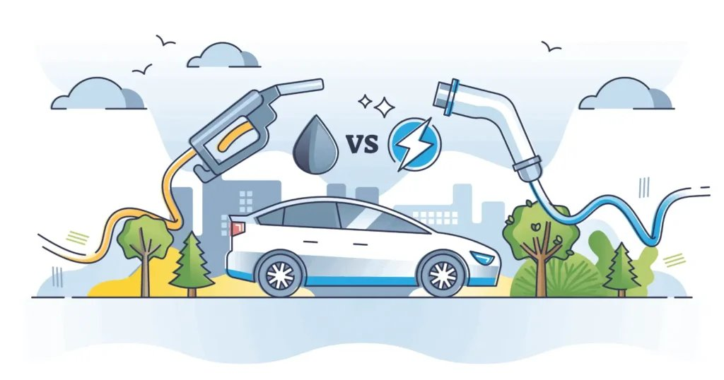
Lower Running Cost
Category | EV Cost | ICE Cost(Internal Combustion Engine) | Notes
Running Cost (per km) | ₹1 – ₹1.5 | ₹6 – ₹8 | EVs are 4–6x cheaper per km
Maintenance Cost (annual) | ₹10,000 – ₹15,000 | ₹15,000 – ₹25,000 | EVs have fewer moving parts, reducing service costs
Government Incentives | GST 5%, subsidies available, tax benefits | GST 28% no subsidies | EVs benefit from central/state incentives
Road Tax & Registration | Exempt or minimal | Applicable (varies by state) | Many states waive EV road tax
Total Cost of Ownership (5 years) | Lower overall despite higher upfront cost | Higher due to fuel & maintenance | EVs save money long‑term
Fuel savings dominate: EVs cost about ₹1/km vs ₹6–8/km for ICE cars.
Maintenance savings: EVs are 30–40% cheaper annually.
Policy support: EVs enjoy lower GST (5%), subsidies, and road tax exemptions.
Overall ownership: Over 5 years, EVs typically have a lower total cost of ownership despite higher upfront prices.
Source

Slide 21

Environmental Awareness
Aspect | Electric Vehicles (EVs) | Petrol/Diesel Vehicles (ICE)
Tailpipe Emissions | Zero – no CO₂, NOx, or particulate matter | High CO₂, NOx, PM emissions → urban air pollution
Carbon Footprint (lifecycle) | 30–50% lower (depends on electricity mix) | High lifecycle emissions from fuel extraction, refining, combustion
Noise Pollution | Very low – quiet operation | Significant engine noise and vibration
Climate Impact | Helps reduce greenhouse gases, supports climate goals | Major contributor to global warming
Air Quality | Improves urban air quality, reduces smog | Worsens air quality, linked to respiratory issues
Consumer Appeal | Strong among eco‑conscious buyers | Increasingly seen as unsustainable
Category | EV (Electric Vehicle) | Petrol/Diesel Vehicle
Production Emissions | 9–10 tCO₂e | 6–7 tCO₂e
Annual Driving Emissions | 1.8 tCO₂e | 4.5 tCO₂e
Lifetime Emissions (10 yrs) | 27–30 tCO₂e | 50–55 tCO₂e
Tailpipe Emissions | -0 | ~4.5 tCO₂e per year
EVs produce zero tailpipe emissions, making them far cleaner in cities.
Even accounting for battery production, EVs typically cut lifetime CO₂ emissions by ~40% compared to ICE vehicles.
Environmental awareness is now a top 3 driver of EV adoption in India, with ~39% of surveyed buyers citing it as a key factor.
Source

Slide 22
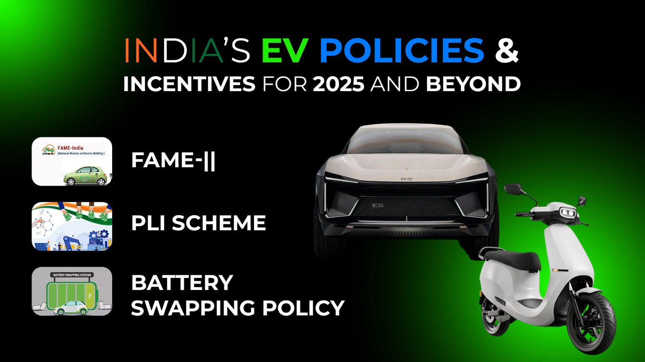
Government Incentives
Incentive Type | Example | Impact on Buyers
FAME II Subsidy | Direct purchase subsidy (~20%) | Lowers upfront cost
Tax Benefit | ₹1.5 lakh deduction on loan interest | Reduces financing burden
State Incentives | Road tax exemption, fee waiver | Improves affordability regionally
Factor | Electric Vehicles (EVs) | Petrol/Diesel Vehicles (ICE)
National Subsidy | FAME II scheme: up to 20% cost reduction | None
Tax Benefits | Section 80EEB: ₹1.5 lakh deduction on EV loan interest | None
State Incentives | Road tax exemption, registration fee waiver, extra subsidies | None
Upfront Cost Impact | Reduced significantly due to combined incentives | No reduction; fuel taxes increase cost
Policy Support | Strong central + state backing for adoption | No direct support, higher regulatory burden
Market Effect | EV penetration rising (6.5% of total sales in 2023) | Petrol/diesel share declining gradually
FAME II Subsidy (20% cost reduction)
Covers electric two‑wheelers, three‑wheelers, and four‑wheelers.
Focuses on public transport (e‑buses) and shared mobility.
Directly lowers upfront purchase cost, making EVs more competitive with petrol/diesel.
Tax Benefit (80EEB, ~10% reduction)
Allows individuals to claim up to ₹1.5 lakh deduction on interest paid for EV loans.
Encourages middle‑class buyers to finance EVs affordably.
Reduces long‑term ownership cost.
State Incentives (~8% reduction)
Road tax exemptions and registration fee waivers in states like Delhi, Maharashtra, Tamil Nadu.
Some states also offer additional subsidies for two‑wheelers and charging infrastructure.
Source

Slide 23
Qn 2 : How do government incentives and subsidies impact the adoption rates of 2-wheelers and 4-wheelers? Which states in India provided most subsidies?

Slide 24
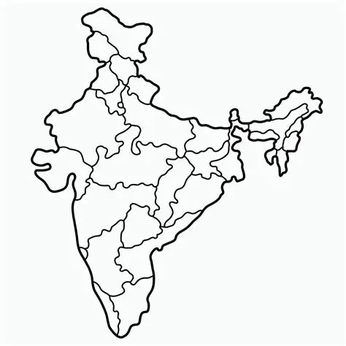
Impact of Government Incentives on EV Adoption (2W vs 4W)
Top EV Incentive States
Aspect | 2-Wheeler EVs (2W) | 4-Wheeler EVs (4W)
Subsidy Impact | High impact – reduces price gap significantly | Moderate impact – still expensive even after subsidy
Sales Growth | Strong growth due to subsidies | Gradual growth due to high upfront cost
Adoption Sensitivity | Very sensitive to subsidy changes | Less sensitive (income segment higher)
Key Scheme | FAME II Scheme boosted demand significantly | FAME-II + state incentives support adoption
Data Insight | +12.7% sales increase per subsidy boost | 211% higher growth in states with incentives
State Policy Effect | 54.5% higher sales in states with incentives | Strong growth where state subsidies exist
Delhi
High subsidy + waiver → Highest adoption
Gujarat
High per‑vehicle subsidy → Boost in 2W adoption
Maharashtra
Early policy push → Strong 2W & 4W growth
Karnataka
Subsidy + EV ecosystem → Tech‑driven adoption
Tamil Nadu
Manufacturing hub + incentives → Strong EV ecosystem
Subsidies directly reduce upfront cost → biggest barrier removed.
2W EV adoption is highly dependent on subsidies.
4W EV adoption depends on cost + technology + infrastructure.
States with incentives recorded up to 54.5% higher EV adoption, especially in 2‑wheelers.
Source

Slide 25
Qn 3: How does the availability of charging stations infrastructure correlate with the EV sales and penetration rates in the top 5 states?

Slide 26

Correlation Between Charging Infrastructure & EV Adoption
Rank | State | Charging Stations | EV Penetration Rate | Key Observations
1 | Uttar Pradesh | 2,901 | ~6–7% | Infrastructure leader, but penetration moderate → infra alone isn’t enough.
2 | Tamil Nadu | 2,010 | ~7.5% | Manufacturing hub; infra + ecosystem drive steady adoption.
3 | Maharashtra | 1,972 | ~8.5% | Strong EV base; chargers heavily utilized, especially for 4W.
4 | Karnataka | 1,901 | ~9.9% | Dense network (esp. Bengaluru); infra strongly correlates with penetration.
5 | Gujarat | 1,470–1,500 | ~6.5% | Subsidy‑driven 2W adoption, supported by infra.
— | Delhi (outside top 5 infra) | ~1,931 | 11.50% | Penetration leader due to aggressive subsidies + tax waivers, despite fewer chargers.
Infrastructure vs Adoption
UP: Infrastructure leader, but penetration moderate (~6–7%).
Delhi: Penetration leader (11.5%) despite not being in top 5 for chargers.
Tamil Nadu: Second in chargers (2,010), steady adoption (~7.5%) thanks to manufacturing ecosystem.
Maharashtra: Strong EV base (1,972 chargers, ~8.5% penetration), chargers heavily utilized.
Karnataka: Dense network (1,901 chargers, ~9.9% penetration), strong correlation between infra and adoption.
Gujarat: ~1,470 chargers, ~6.5% penetration, subsidy-driven adoption.
Correlation Takeaway:
Infrastructure alone doesn’t guarantee adoption (UP).
Subsidies can offset infra gaps (Delhi).
Balanced states (MH, KA, TN, GUJ) show how infra + ecosystem sustain growth.
Source

Slide 27
Qn 4: Who should be the brand ambassador if AtliQ Motors launches their EV/Hybrid vehicles in India and why?

Slide 28
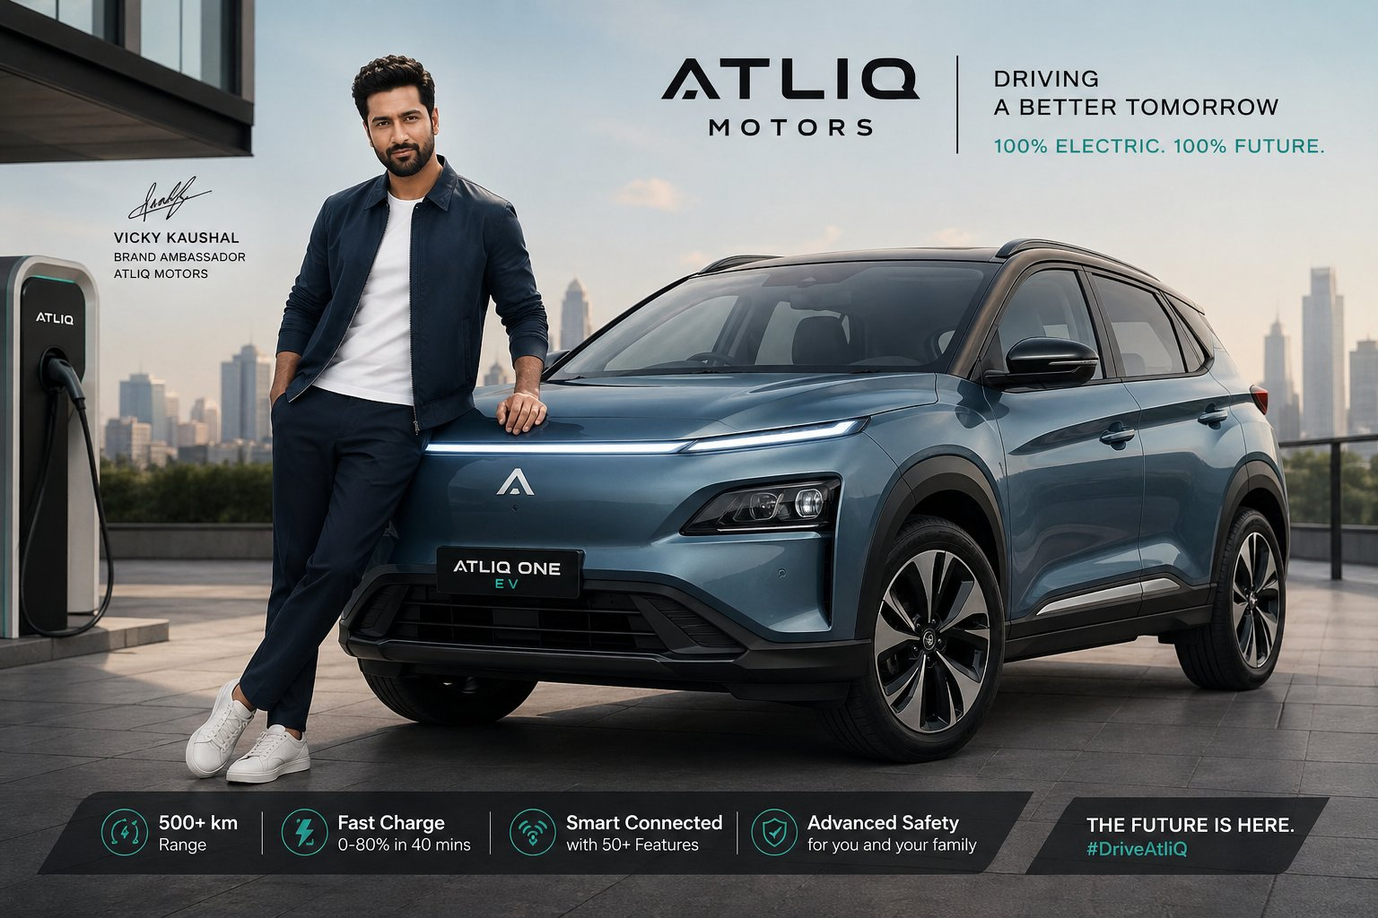
brand ambassador for AtliQ Motors
Vicky Kaushal is the ideal brand ambassador for AtliQ Motors due to his strong association with EVs, relatable personality, and appeal among urban consumers, making him a perfect fit to promote sustainable and innovative mobility solutions in India.

Slide 29
Qn 5 : Which state of India is ideal to start the manufacturing unit? (Based on subsidies provided, ease of doing business, stability in governance etc.)

Slide 30
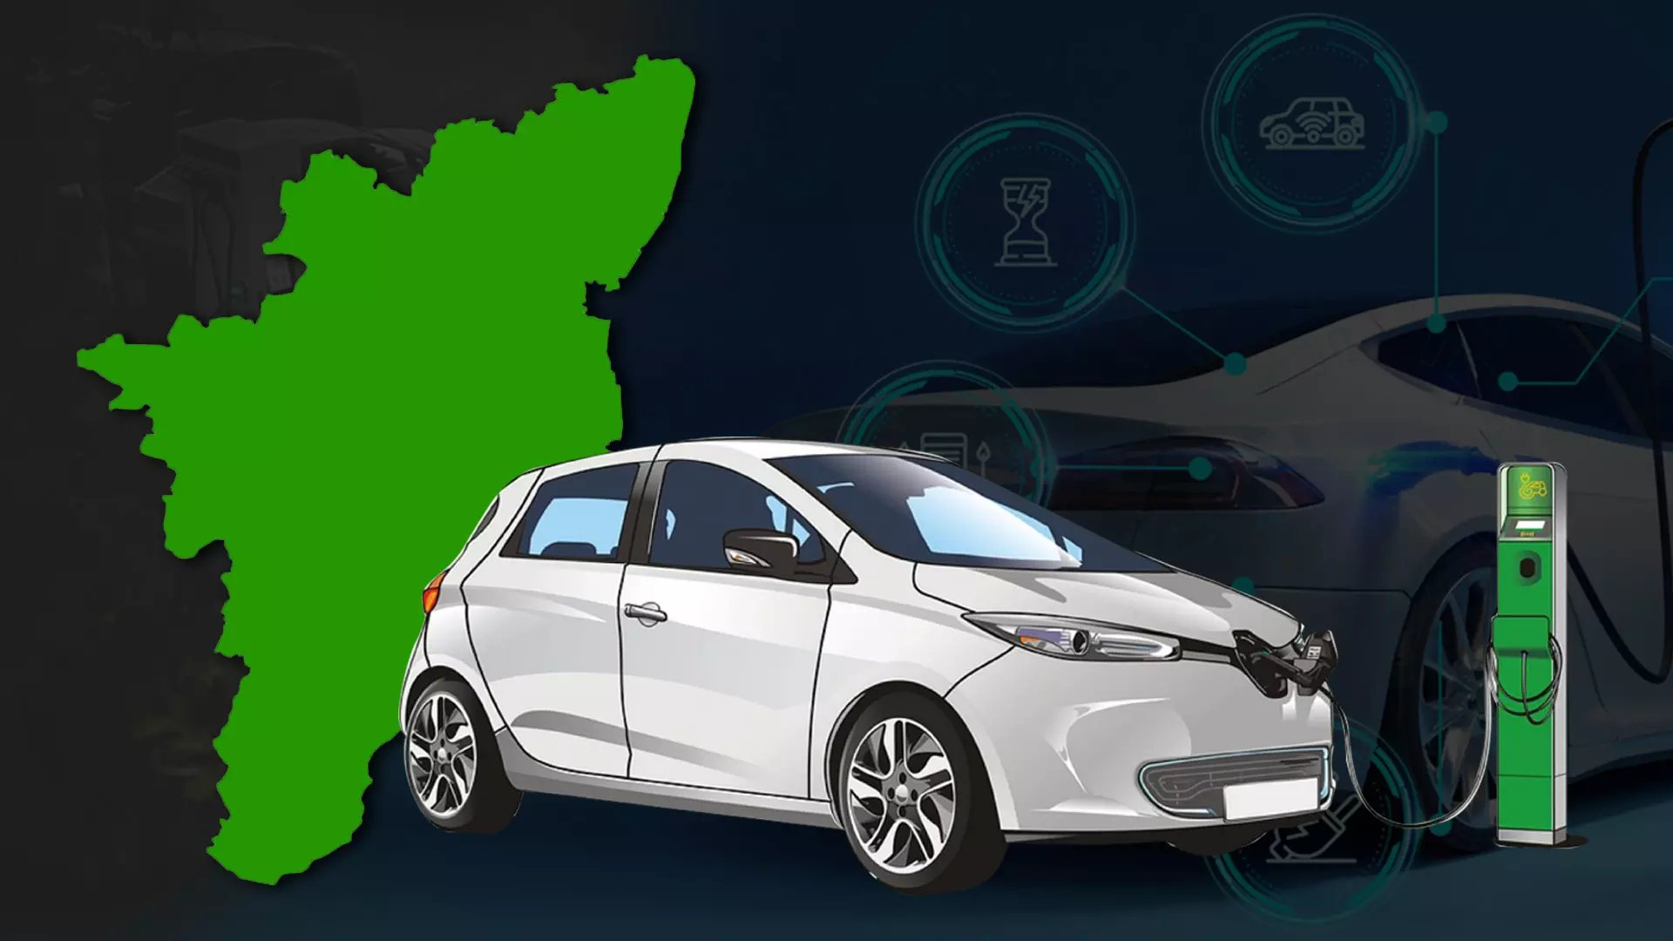
Strategic Location Analysis for EV Manufacturing in India
State | Business Environment Score (2025) | Rank | Key Strengths
Tamil Nadu | 7.4 | 1 | Industrial hub (automobiles, electronics, renewables), strong policies, stable governance
Gujarat | 7.3 | 2 | Investor magnet, robust industrial base, strong infrastructure
Maharashtra | 7.1 | 3 | Economic powerhouse, auto hub, ambitious MSME & infra investments
Karnataka | 6.9 | 4 | IT & biotech hub, sunrise sectors (AI, green hydrogen), balanced growth
Delhi | 6.9 | 4 | Startup magnet, finance & IT, infrastructure modernization
Tamil Nadu leads India’s 2025 Business Environment Rankings with a score of 7.4, offering the strongest combination of subsidies, ease of doing business, and governance stability , making it the most strategic choice for AtliQ Motors’ EV manufacturing unit.
Source

Slide 31
Qn 6 Top 3 recommendations for AtliQ Motors.

Slide 32
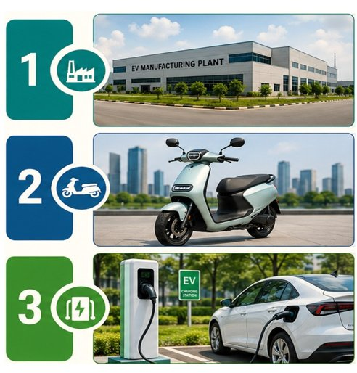
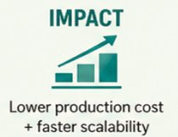

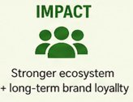
Top 3 Recommendations for AtliQ Motors
Strategic actions to accelerate growth and strengthen position in India’s EV market
Establish Manufacturing in Tamil Nadu
Strong automotive ecosystem and supplier base
Skilled workforce and technical talent availability
Excellent port connectivity for exports
Attractive incentives and investor-friendly policies
Focus on Affordable 2W &
Entry-Level EV Segment
2-wheelers drive majority of EV adoption in India
Price-sensitive market with high growth potential
Government subsidies boosting demand
Quick market penetration and higher sales volume
Invest in Charging
Infrastructure Partnerships
Charging infrastructure is key to EV adoption
Reduces range anxiety and builds customer trust
Partner with leading players like
Tata Power
Ather Energy

